Slide 1
HAWK EYE
By:-
AJAY CHAUDHARY

Slide 2
Table of content
Introduction
Software and Platform
Libraries
List of modules
Motion Detection
Motion Tracking
Motion Recording
Color Tracking
Object Tracking 1
Object Tracking 2

Slide 3
Introduction
Hawk Eye is a platform independent computer vision based software.
It can perform various tasks like motion detection, motion recording, object tracking, etc.
Computer Vision is interdisciplinary field that deals with how computers can be made for gaining high level understanding from digital images or videos.

Slide 4
Introduction
Computer Vision tasks include methods of acquiring, processing and analysing and understanding digital images.
Computer Vision uses computer to emulate human visions, including learning and being able to make inferences and take actions based on visual inputs.

Slide 5
Software & platform
Language : Python
Platform : Tkinter
Software : Anaconda-5.1.0 (Python-3.6.4)
Editors : Jupyter Notebook, Spyder, VS Code
Hardware : Webcam

Slide 6
Libraries used
OpenCV 3.3.0 :
An intel initiative Open Source Computer Vision library
Numpy 1.11.3 :
NumPy is the fundamental package for scientific computing with Python
Matplotlib 2.1.0 :
Matplotlib is a python 2D plotting library which produces publication quality
Dlib 19.9.0 :
We can do object tracking relatively easier with the help of dlib and OpenCV libraries.

Slide 7
List of modules in Hawk eye
Motion Detection
Motion Tracking
Motion Recording
Color Tracking
Object Tracking 1
Object Tracking 2

Slide 8
Motion Detection
If we wish to detect a motion of a particular subject then we first subtract background image from the original image.
Suppose we are trying to detect moving car on the road. Then if we have image of empty road ( a road with no car) then we can easily detect the motion of car by just comparing background image with original image.
Motion detection for steady background can be implemented by following function of OpenCV library : BackgroundSubtractorMOG2

Slide 9
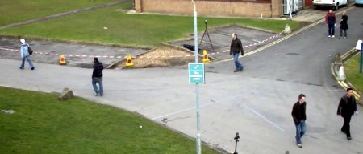
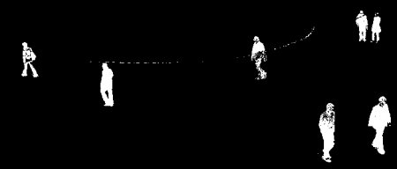
Motion Detection
Results of BackgroundSubtractorMOG2 function of OpenCV library
Original Image
Result of BackgroundSubtractorMOG2

Slide 10
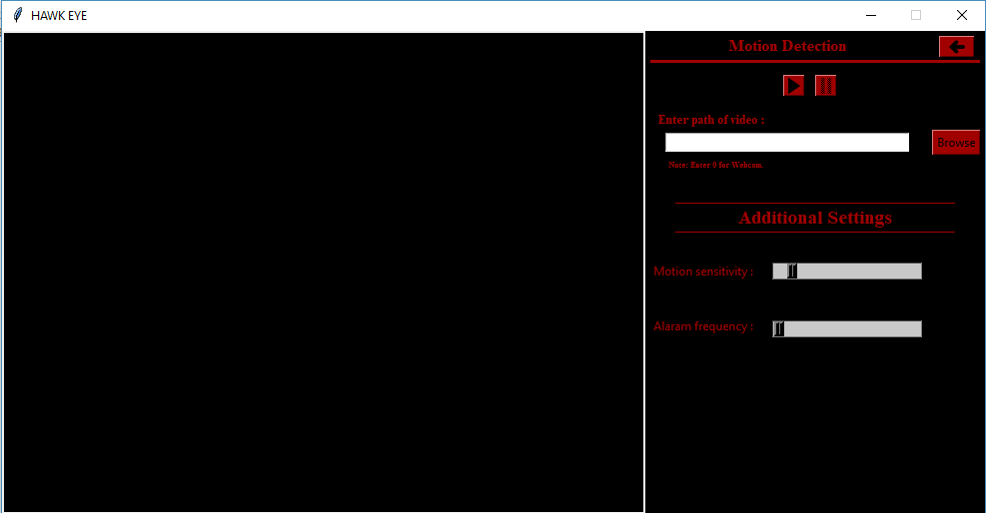
Motion Detection
Back Button
Play & Pause Button
Browse video from local storage or enter 0 (zero) for Webcam
Your video will play here.
Set value for motion in video (0 to 50,000)
Set value for alarm sound (37 to 6,000)
Motion Detector

Slide 11
Motion Detection

Slide 12
Motion detection
Applications :
Intruder Alarms
Automatic doors
Hand dryers
Automatic sinks/toilet flusher
Limitations :
Works for only steady camera not for a moving camera.

Slide 13
Motion tracking
Motion Tracker in Hawk Eye can track motion by the BackgroundSubtractorMOG2 function of OpenCV library.
Motion tracker in Hawk Eye also allows you to set the maximum area for tracking.
Motion area can be treated as maximum contour area.
Here contours or bounding rectangle are drawn on the output of background subtractor.

Slide 14
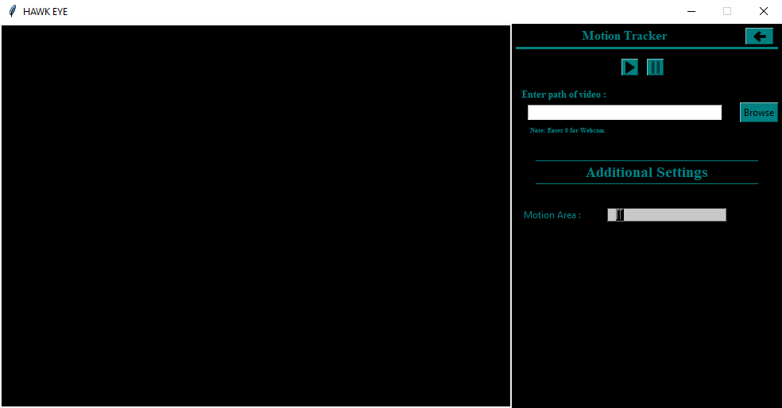
Motion Tracking
Back Button
Play & Pause Button
Browse video from local storage or enter 0 (zero) for Webcam
Your video will play here.
Set value for maximum motion area in video (0 to 400)
Motion Tracker

Slide 15
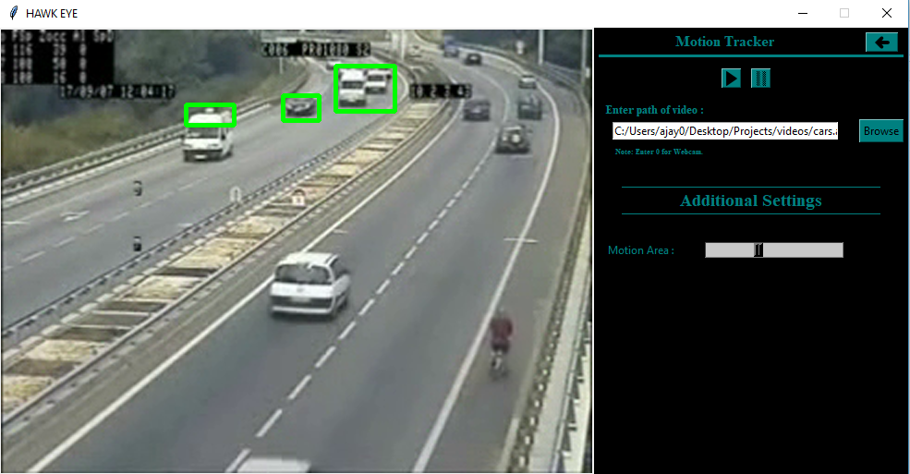
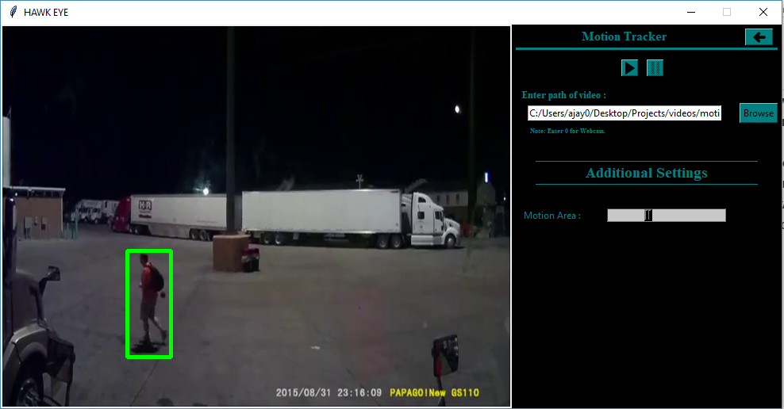
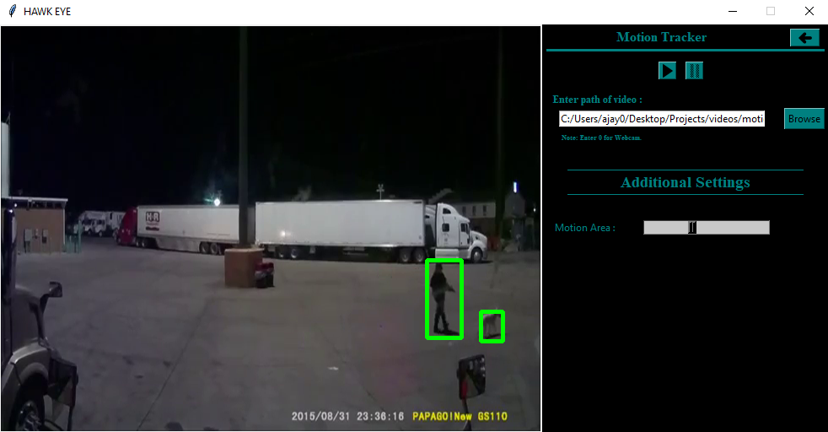
Motion tracking

Slide 16
Motion tracking

Slide 17
Motion Tracking
Applications :
Military surveillance
Medical applications for tracking small particles.
And various other industrial applications.
Limitations :
Requires good quality video and good lightning conditions.

Slide 18
Motion Recording
Motion Recorder in Hawk Eye can be used to record only those video parts that has motion in the video.
Motion Recorder can save a huge amount of storage by discarding the video parts that has no motion.
Hence it can also save a lot of time if any post processing on videos is to be done.
Motion Recorder uses background subtractor from OpenCV library and histogram calculation from Matplotlib library.

Slide 19
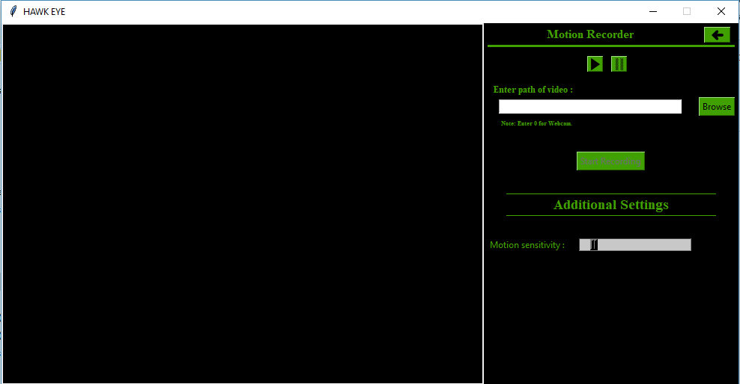
Motion recording
Back Button
Play & Pause Button
Browse video from local storage or enter 0 (zero) for Webcam
Your video will play here.
Start recording button gets activated for use once you select video source
Select what value of motion you want to record. (0 to 50,000)
Motion Recorder

Slide 20
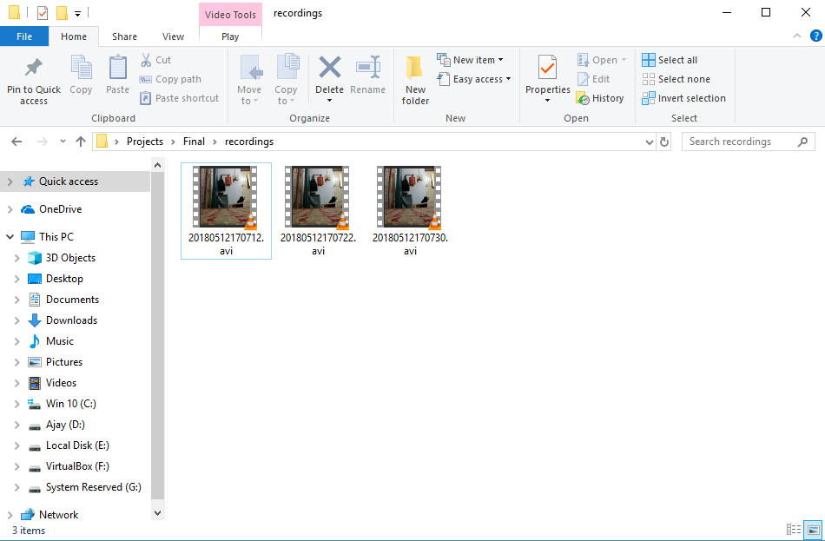
Motion recording
Output videos of motion recorder

Slide 21
Motion recording

Slide 22
Motion recording
Applications :
Surveillance with less storage for video recording.
More days can be covered for surveillance as only useful part is recorded.
Limitations :
May lead to extra processing if most part of the video has motion.

Slide 23
Color Tracking
Color Tracker in Hawk Eye can be used to track object of a specific color in the video.
Color Tracker can track multiple objects of same color.
Here every image of video source is converted from BGR Color space to HSV color space.
Then filtering of selected color from every image is done based on Hue , Saturation and Value.

Slide 24
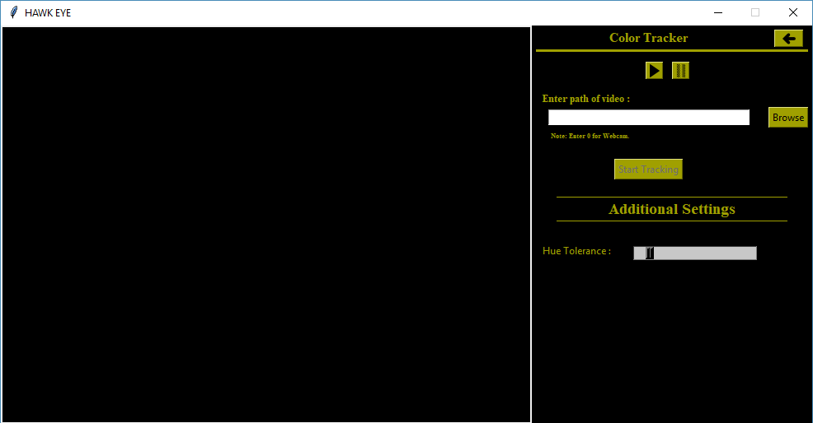
Color Tracking
Back Button
Play & Pause Button
Browse video from local storage or enter 0 (zero) for Webcam
Your video will play here.
Start tracking button gets activated for use once you color from video.
Select what range of hue you want to add and subtract from the color. (0 to 50)
Color tracker

Slide 25
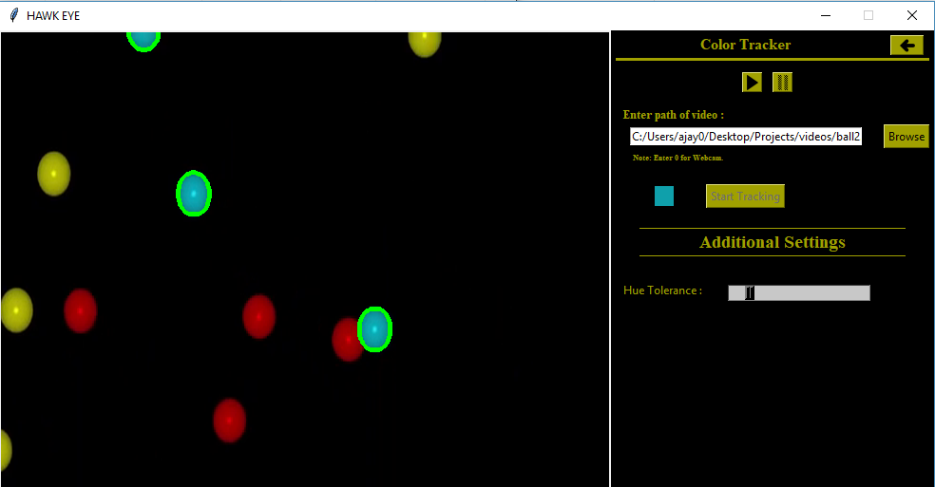
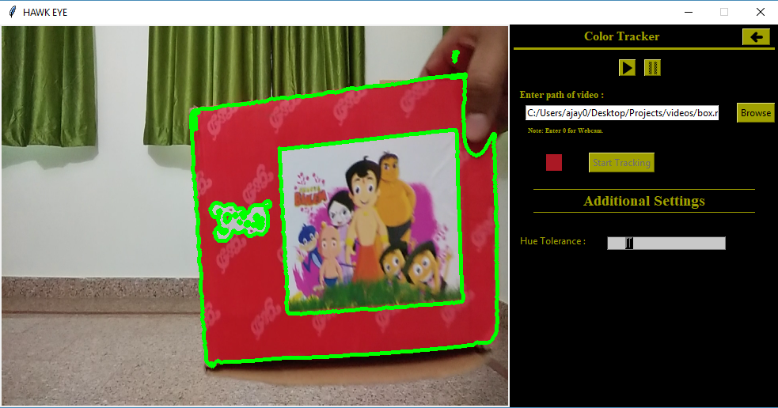
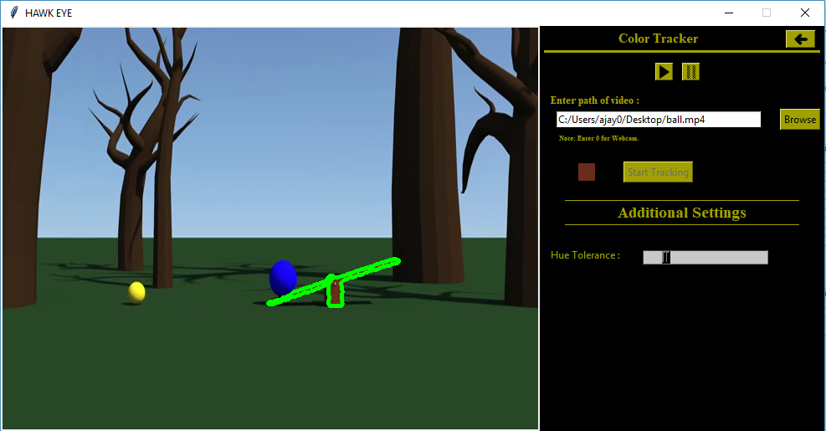
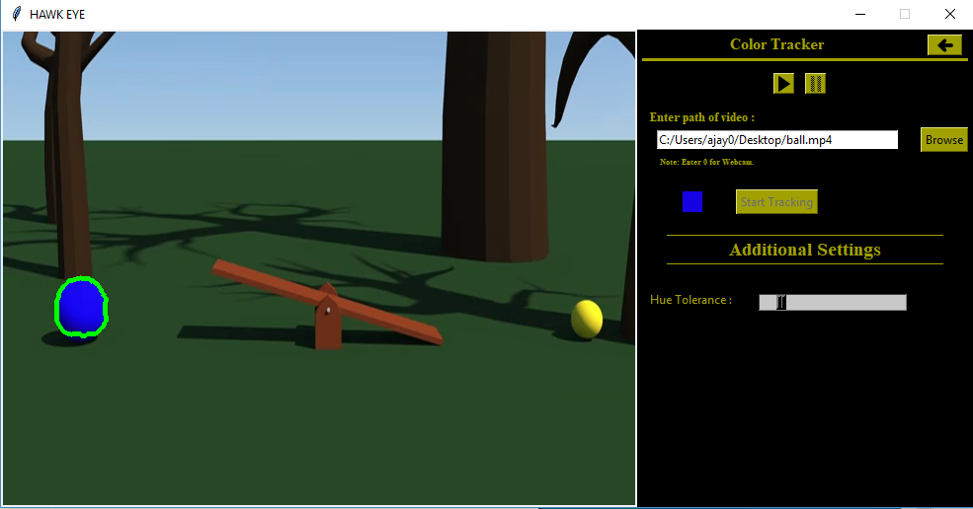
Color Tracking

Slide 26
Color Tracking

Slide 27
Color Tracking
Applications :
Can be used to track multiple objects of same color.
Can be used in manufacturing industries where specific color is to be neglected or accepted.
Limitations :
May give poor results for very dark or very light colors.
Tracking can be done only for a single color at a time.

Slide 28
object tracking 1
Object Tracking 1 in Hawk Eye can be used to track object based on user-defined keypoints.
Object Tracking 1 uses Lucas Kanade Optical Flow algorithm to track keypoints.
User can plot the keypoints and those keypoints will be tracked based on Lucas Kanade Optical Flow algorithm.
If the keypoints are lost they will be discarded.

Slide 29
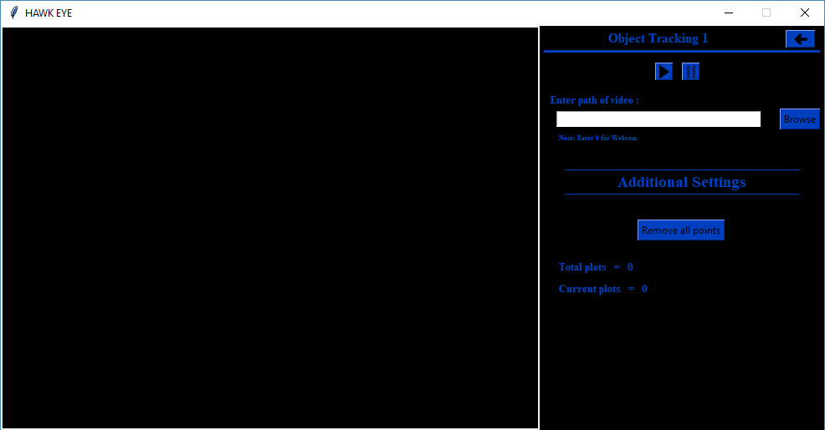
object tracking 1
Back Button
Play & Pause Button
Browse video from local storage or enter 0 (zero) for Webcam
Your video will play here.
Remove all keypoints that are plotted and start again.
Count of the keypoints that were plotted and are currently active.
Object tracker 1

Slide 30
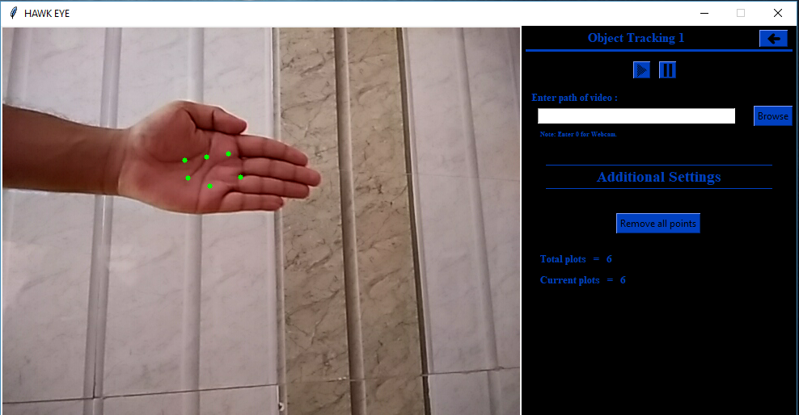
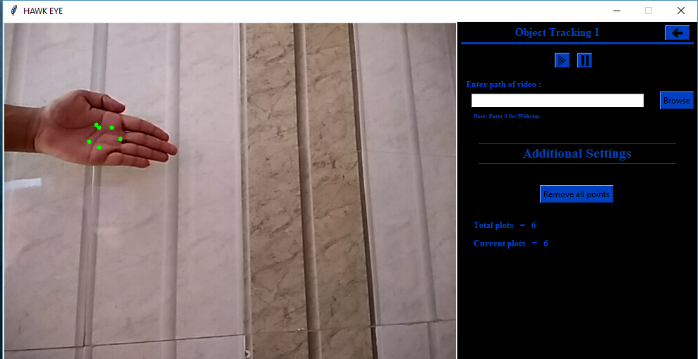
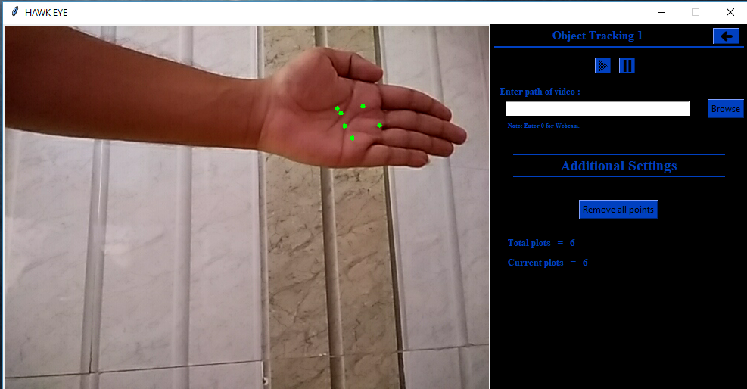
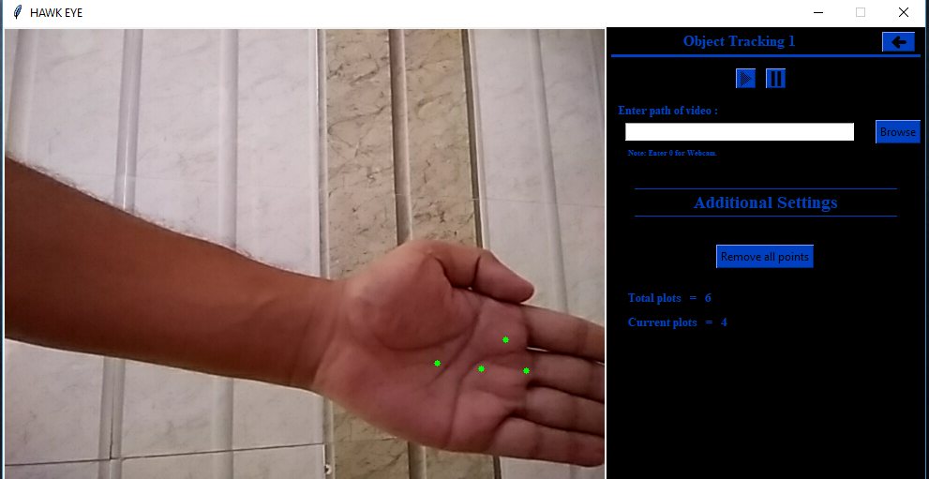
object tracking 1

Slide 31
object tracking 1

Slide 32
object tracking 1
Applications :
Track object based on user-defined keypoints.
Can also track object when camera is moving.
Limitations :
It can not identify if the object is still present In the video frame or not.

Slide 33
object tracking 2
Object Tracking 2 in Hawk Eye can be used to track object based on user-selected area.
Object Tracking 2 uses two algorithms SURF (Speeded-Up Robust Features) algorithm and Lucas Kanade Optical Flow algorithm.
SURF algorithm is used to find keypoints.
Lucas Kanade Optical Flow algorithm is used to track keypoints.

Slide 34
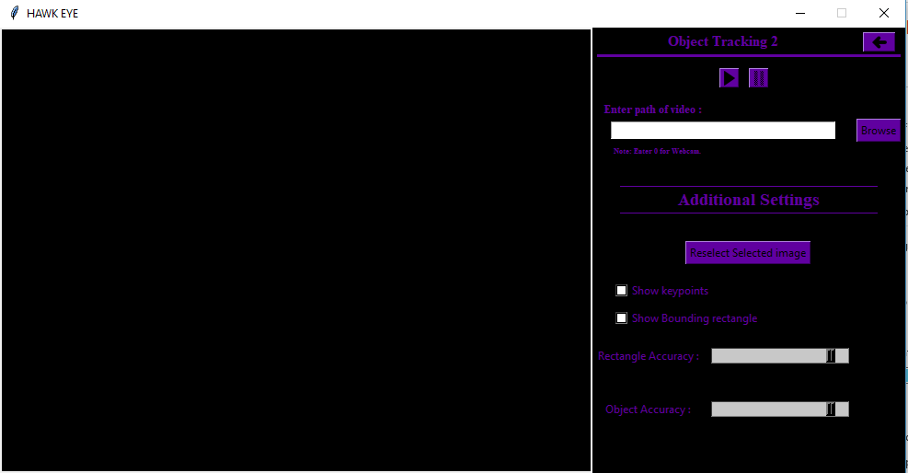
object tracking 2
Back Button
Play & Pause Button
Browse video from local storage or enter 0 (zero) for Webcam
Your video will play here.
Select the object again
Toggle keypoints
Toggle rectangle around object
Accuracy of rectangle around object.
Accuracy of object based on keypoints.
Object tracker 2

Slide 35
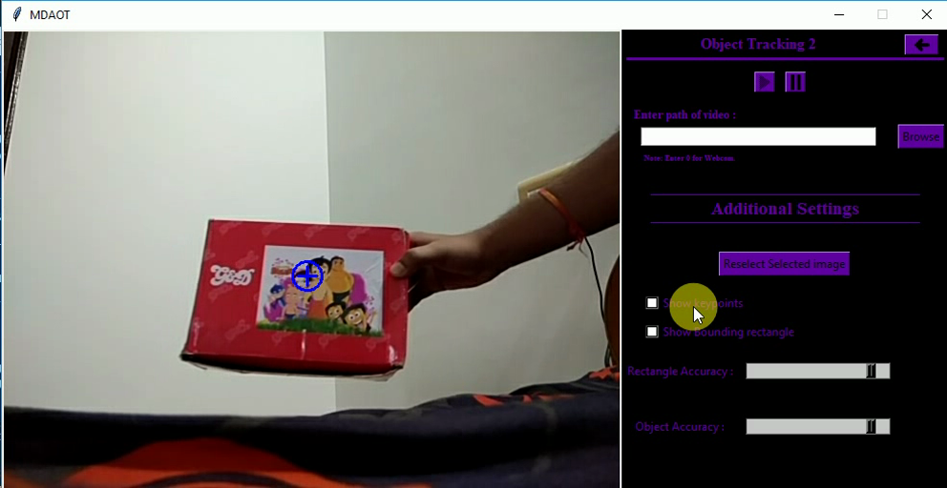
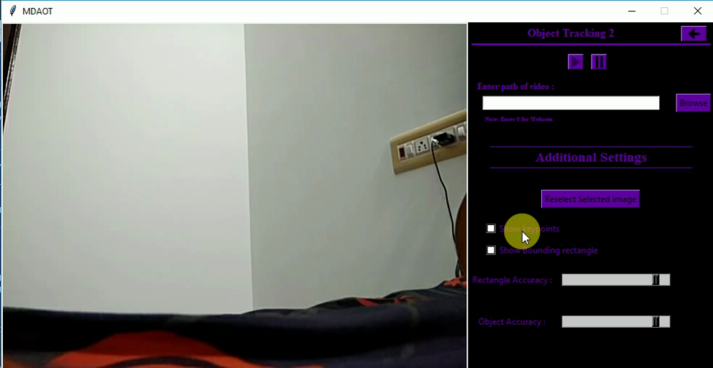
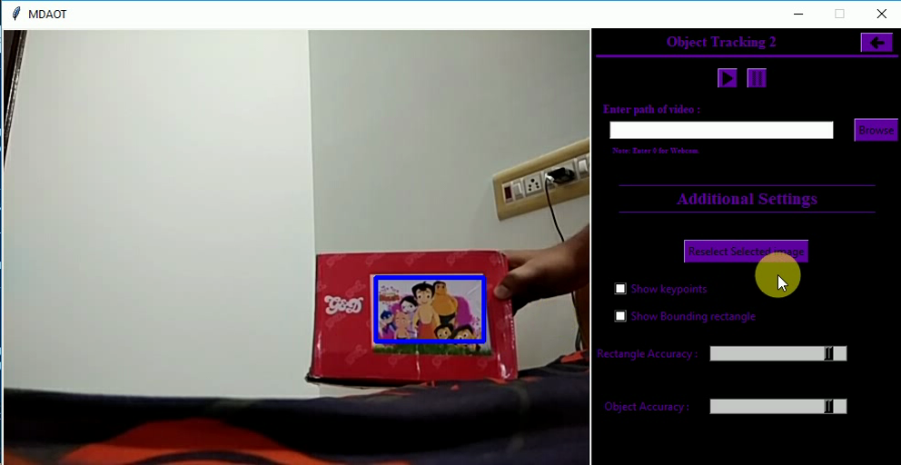
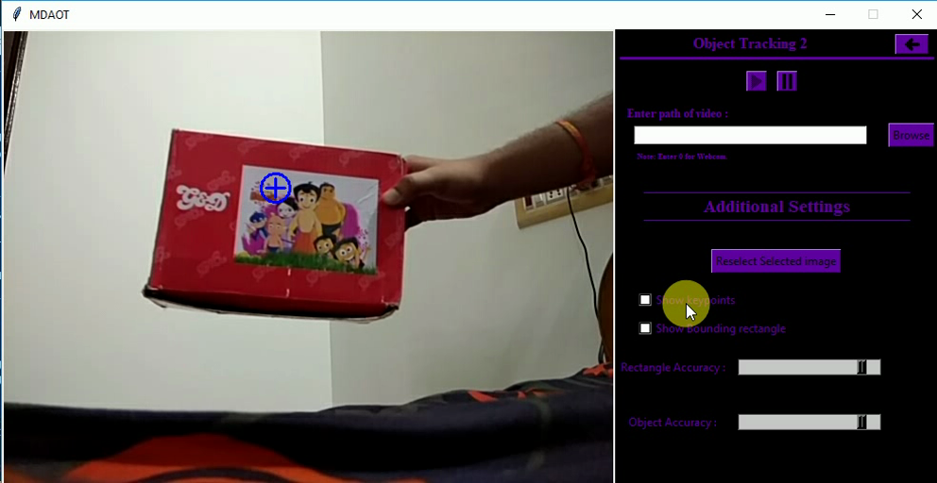
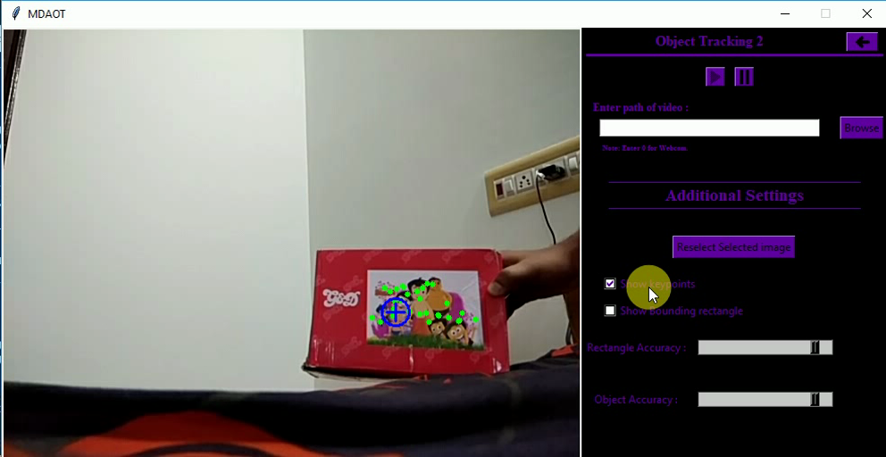
object tracking 2

Slide 36
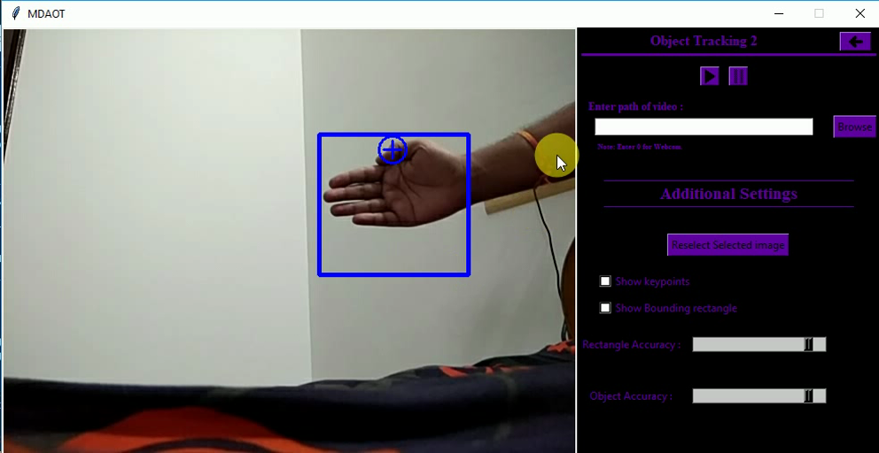
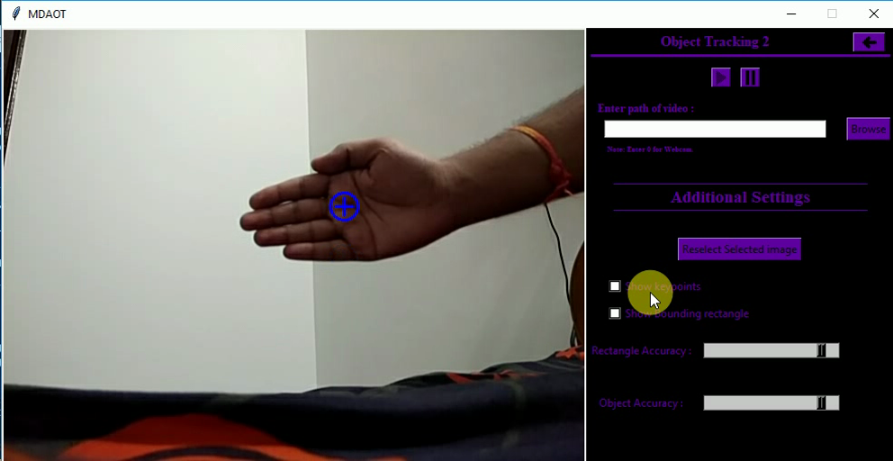
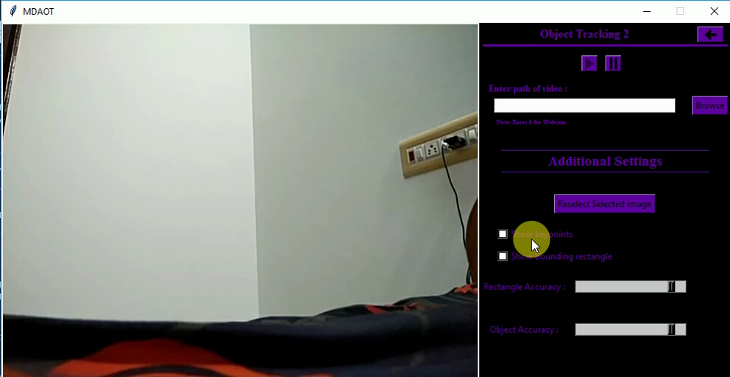
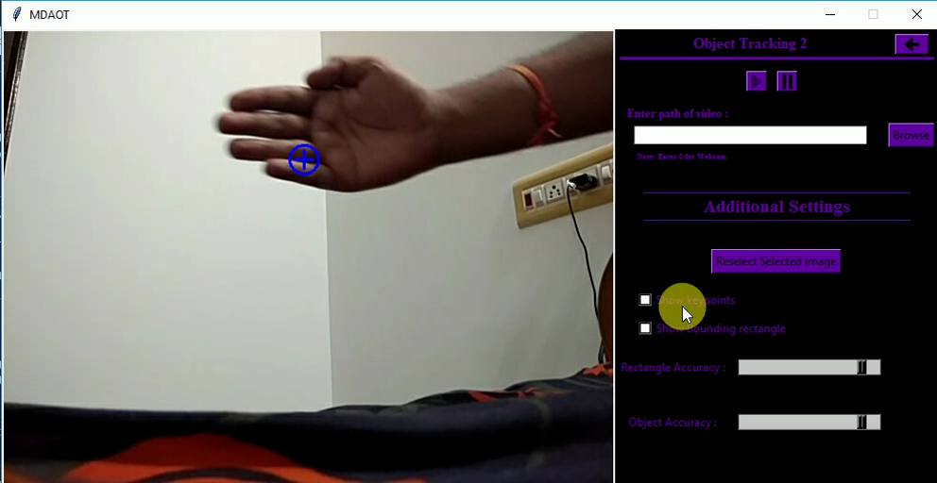
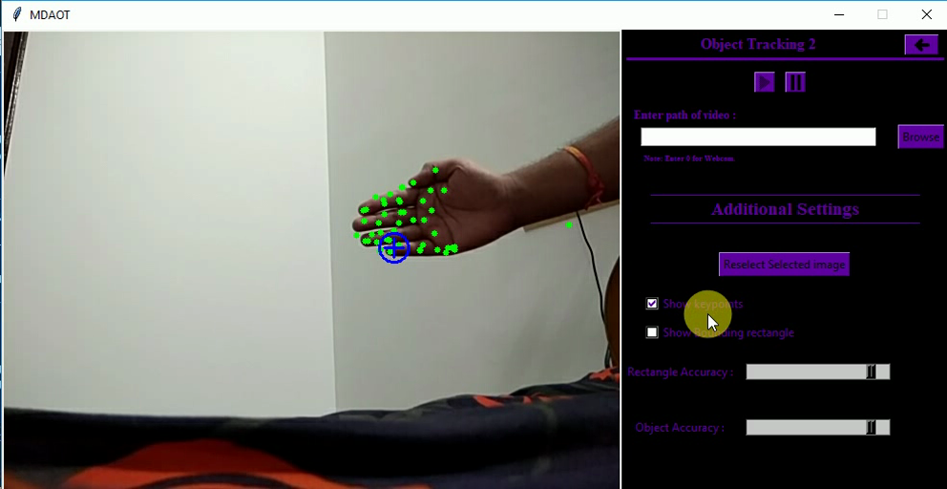
object tracking 2

Slide 37
object tracking 2

Slide 38
object tracking 2
Applications & Advantages :
Track object based on user-selected object or part of object.
Can also track object when camera is moving.
It can identify when object is not present in the video frame.
Limitations :
It is slower in comparison to Object tracking 1.

Slide 39
Thank You

